Slide 1
Chapter 2
Data Models

Slide 2
Data Modeling and Data Models
Data modeling: creating a specific data model for a determined problem domain
  Data model: simple representation of complex real-world data structures
    Useful for supporting a specific problem domain
  Model: abstraction of a more complex real-world object or event
  The data model’s main function is to help us understand the complexities of the real-world environment. The database designer uses data models to facilitate the interaction among designers, application programmers, and end users.

Slide 3
The Relational Data Model
At the heart of any database design is a DATA MODEL
Will focus on the Relational Data Model in this course.
Databases based on Relation Model is known as Relational Databases
DBMS that manages relational database is known as Relational DBMS
Examples:
  MS - SQL Server
  Oracle
  DB/2
  MySQL

Slide 4
The Relational Model
The basic structure in a Relational model is a RELATION (or table)
Relation
  A 2-D structure composed of rows and columns.
  Each row is called a Tuple or a record
  Each column represents an attribute.
  Provides a logical view of data.
Relational Database is composed of a collection of relations.
  The relations are related with one another.
  These relationships are implemented by incorporating a column that is common to tables in the relationship.
  Relation

Slide 5
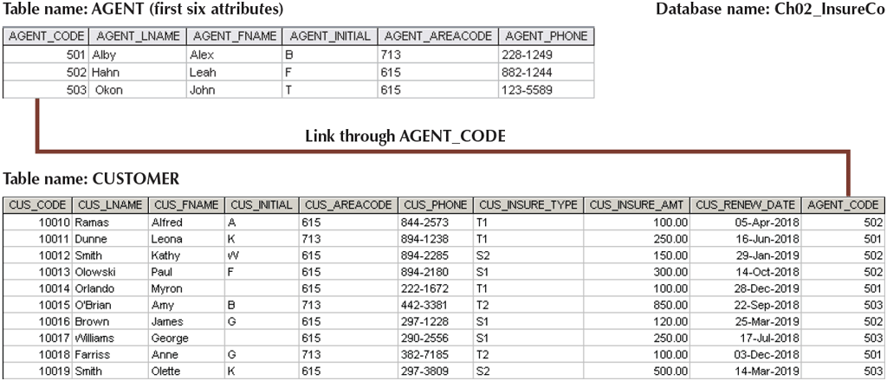
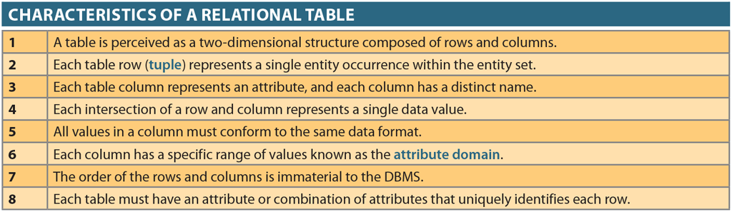
Relation - Example

Slide 6
Business Rules
Business rules form the basis of the data modeling process
Business rules are precisely written and unambiguous statements that are derived from a detailed description of an organization's operations.

Slide 7
Discovering Business Rules
Sources of business rules
  Company managers
  Policy makers
  Department managers
  Written documentation
  Direct interviews with end users

Slide 8
Examples of Business Rules
Examples of business rules are:
A store employs many employees.
Each employee is employed by only one store.
A college has many departments.
Each department belongs to a single college. (This business rule reflects a university that has multiple colleges such as Business, Liberal Arts, Education, Engineering, etc.)

Slide 9
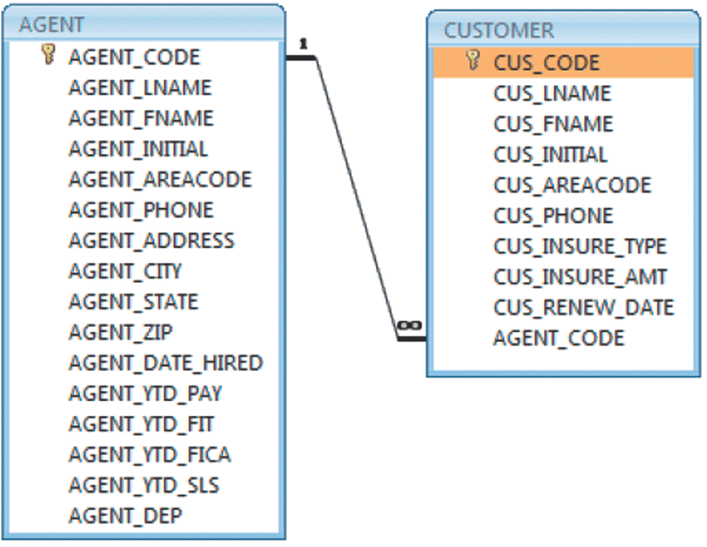
Relational Model - Representation

Slide 10
Constraints
Relational models cannot always reflect all of the business rules. For example, examine the following business rule:
A customer cannot be given a credit line over $10,000 unless that customer has maintained a satisfactory credit history (as determined by the credit manager) during the past two years.

Slide 11
Relational database management system (RDBMS)
Relational database management system (RDBMS)
  Performs basic functions provided by the hierarchical and network DBMS systems
  Makes the relational data model easier to understand and implement
  Hides the complexities of the relational model from the user

Slide 12
How to Store, Manage, and Retrieve Data
The primary means is the Structured Query Language (SQL)
Types of SQL Statements:
  Data Definition Language (DDL)
    Statements that define and manage the structure of the database
    Create statement – to create any database object – database, table, view, procedure
  Data Manipulation Language (DML)
    Statements that retrieve and manipulate data
    Select statement for retrieving data
    Insert statement for storing data
    Delete statement for deleting data
    Update statement for updating current data
Together, DDL and DML perform CRUD operations on databases.

Slide 13
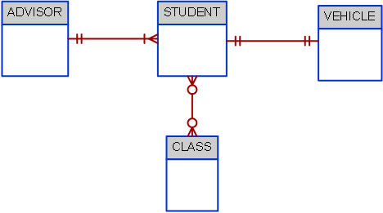
Business Rules Exercise 1

Slide 14
Business Rules Exercise 2

Slide 15

Business Rules Exercise 3

